Slide 1


^{THE TREASURY HUB} ^{Markets Bulletin}
^{Q2 2025 Review}
Disclaimer:
All statements presented in the bulletin are based on the opinion of the author and facts.
The author cannot be held responsible for any action taken on items discussed in the bulletin.

Slide 2
Q2 2025 Markets
1. Executive Summary
1.2 Markets in a Table: what’s up and what’s down?
Table 1. Key Metric Movements: 2025 to date
1 | Executive Summary | 2
2 | Foreign Exchange, Oil & Carbon | 3
3 | Interest and Economic Review | 5
4 | Wealth Management | 7
5 | Macro Commentary | 8
1.1 Introduction
Welcome to the second TREASURY HUB Markets Bulletin of 2025.
As you are aware, these bulletins cover quite a wide range of topics and are a comprehensive review of all the various interest rate, foreign exchange, commodity and stock markets. Table 1 across sets out the 2025 movement in a number of key metrics. And what a volatile first half of the year it has been mainly due to actions and words of a certain D Trump!
While the focus of markets over 2024 was on inflation/interest rate cuts, and this still remains the case, there has been a huge amount of volatility in foreign exchange rates and equity markets to mention but two categories and the US deficit and large debt is finally getting the attention that it deserves - a few years after we first started talking about it here!
3-month Euribor continued to fall over the quarter as expected in line with the actual (and ongoing) cuts in the ECB Base Rate. The ECB Deposit Rate has been cut four times in 2025 to date (most recently on June 11^{th)} to its current level of 2.00%.
The shape of the EUR yield curve is now normal i.e. upward sloped from 1 year whereas both the UK and US yield curves decline between 1 and 2 years and climb thereafter.
Both of these suggest that the bottom of the interest rate cycle will be reached in 2025 (EUR) OR 2026 (UK and US) after which rates could move upwards in due course.
Please note that the % moves are in green if the metric has moved upwards and in red if it has moved downwards. It is NOT a statement as to whether this is a positive or negative move as one could be a borrower or depositor, a seller or buyer of currency, etc. Also, the % move for interest rates is in absolute terms while for currency and equities it is expressed in relative terms. PLEASE NOTE THAT INTEREST RATE TRENDS ARE FROM A DEPOSITOR PERSPECTIVE.
Oil prices have moved around a lot – initially declining in the first 4 months of the year as the prospects of a recession loomed but the military strikes on Iran led to a sudden rise in price as most of the world’s oil moves through the Strait of Hurmuz.
Gold continues on its amazing run as countries and others hedge their bets on the continuing dominance of USD.
US stock markets (Dow and Nasdaq) have recovered after the earlier slump but the ISEQ and FTSE appear to be performing better.
Both GBP and USD have weakened against EUR over the year to date.
Page 2

Slide 3
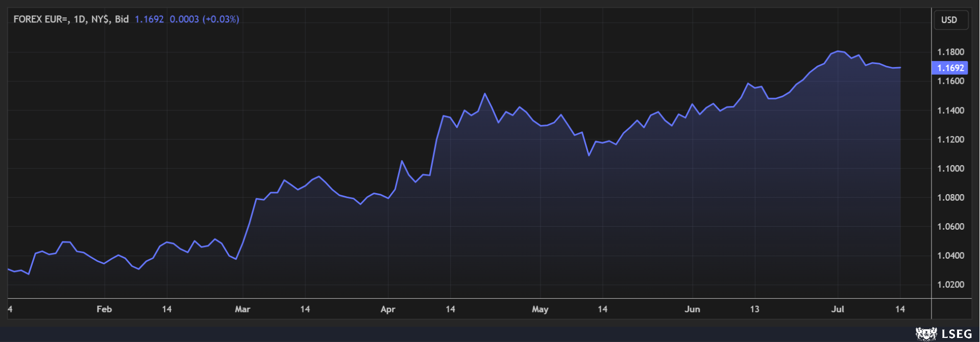
Q2 2025 Markets
1.2 Forward-looking Indices
Forward-looking indictors known as Purchasing Manager Indices or PMIs are useful to monitor the economic outlook for Ireland and the UK. Readings above 50 indicate expansion while below 50 denote contraction.
ROI manufacturing reading has improved since the last quarter but there has been a sizeable decrease in the Services reading
In the UK, two of the three readings remain below 50 indicating a contraction in activity while the Services figure is back in expansion territory so an ongoing mixed outlook for the UK.
Table 2. Irish and UK PMI readings
Ireland UK
Manufacturing PMI 53.7 47.7
Services PMI 51.5 52.8
Construction PMI 48.6 48.8
1.3 Inflation
Table 3. Selected Inflation Rates
CPI/Core Inflation
ROI 2.00%
EUROZONE 2.30%
UK 3.50%
US 2.80%
Note: Core figures exclude energy, mortgages and food.
Irish core rate continued to ease dropping to 1.9% in May and it appears to have bottomed out rising slightly in June. CPI shows food prices were at 4.6% in June and this is grabbing headlines.
Eurozone core inflation trend is not dissimilar with the current reading being the lowest since January 2022, all of which justifies ECB decisions to cut rates but with the inflation rate also stabilising around current levels, it may reflect the increased thinking that rate cuts are close to if not at the end of the cycle.
UK core inflation data is far more volatile by comparison and, looking at a graph of the metric, the trend, if anything, is slightly upwards since September of last year.
Finally, US core inflation is also at its lowest rate since March 2021 for the past three months but the prospect of high levels of tariffs translating into inflation hovers over this metric and bear in mind that inflation is also a lagging indicator.
In summary, the overall trend in general is downwards/flattening which has facilitated lower interest rates but tariffs and their possible knock-on effect on inflation remains the key concern.
See Section 3 for further comment.
2. Foreign Exchange, Oil & Carbon
2.1 EUR/USD
Graph 1 looks at the EUR/USD rate trend for the year to date
The trend in the graph says it all: USD is pretty much weakening since the start the year – sudden adverse moves have arisen around tariff statements emanating from the US. As a result the high/low range in the first half of the year of over 16% is larger than the FULL YEAR range for every year since 2017 with one exception (2022). The average FX rate for the year to date is also weaker (and trending toward further weakness) than the previous three years which is NOT good news for exporters
All of this would suggest that more volatility is to follow as the tariffs situation evolves
To put figures on the above, having started the year at EUR/USD1.0353, it has peaked at EUR/USD1.1805 before settling back to a current level of EUR/USD1.1694
August 1st is the date that President Trump said 30% tariffs will commence on EU goods which would be hugely detrimental to both economies
So EUR/USD1.2000 looks on the cards in that scenario…could even move higher.
Graph 1. EUR/USD: YTD trend
2.2 EUR/GBP
Similarly, EUR/GBP has mirrored the trend in EUR/USD to a certain extent although the moves have not been as extreme.
The high/low range for the year-to-date is 6.06% (prior year 12-month figure was 5.64%).
Current levels represent a second period of weakness in 2025 with the rate at EUR/GBP0.8669.
Page 3

Slide 4
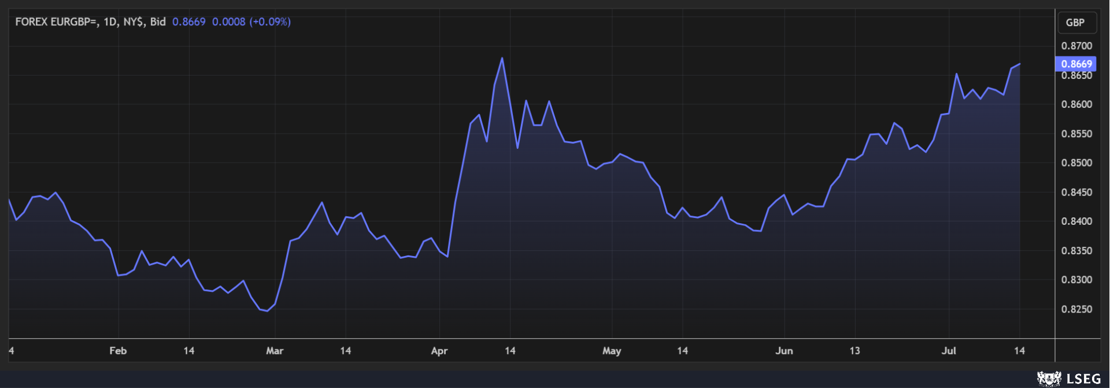
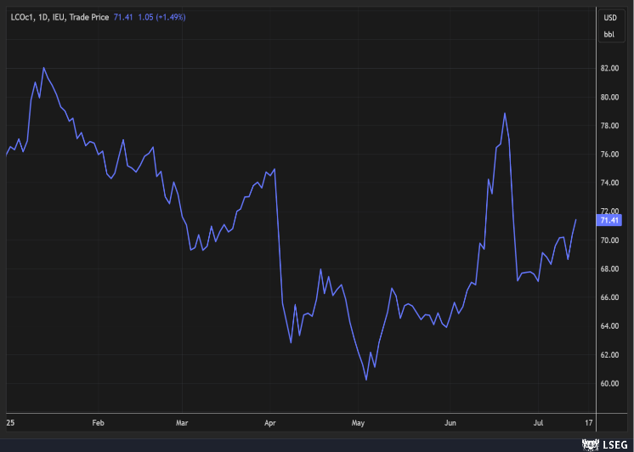
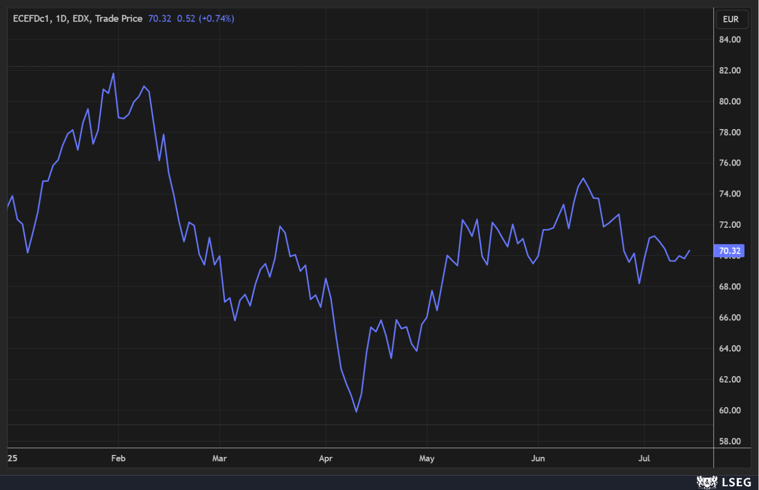
Q2 2025 Markets
As the graph below indicates, the year-to-date trend has been upward i.e. weakening, coming off a low around EUR/GBP0.8250 at the start of March. The danger for exporters is that after a good 2024 which saw GBP at levels not seen in a number of years, the rate has retraced again to averages of the previous few years. This reduction in revenue/profitability in EUR terms is coming at a time when tariffs could slow economies down even further
And forward points also work against exporters - a current spot rate of EUR/GBP0.8669 translates into a forward rate in December of EUR/GBP0.8762 or thereabouts.
Graph 2. EUR/GBP: YTD trend
2.3 OIL & CARBON
Brent Crude had been in a broad downward trend since April last year, with occasional retracements, as concerns about the state of global developed economies weighed on future demand for oil. The sudden spike in Q2 was directly linked to geopolitical matters: the Israeli and US strikes on Iran could have reduced the flow of oil tankers through the Strait of Hormuz thereby impacting negatively on supply. However it was short-lived as Iran’s response was muted. The quick retracement has stalled as markets settled. Again, tariff actions can impact on this as if they slow down economic growth, they reduce demand for oil!
The price of Carbon dropped to EUR60 at the start of April but is back in a range of EUR60 to EUR80 since, which is pretty much where it has been since October 2023. No reason for this to change for now.
Graph 3. Oil YTD trend Graph 4. Carbon: 12-month trend
Page 4

Slide 5
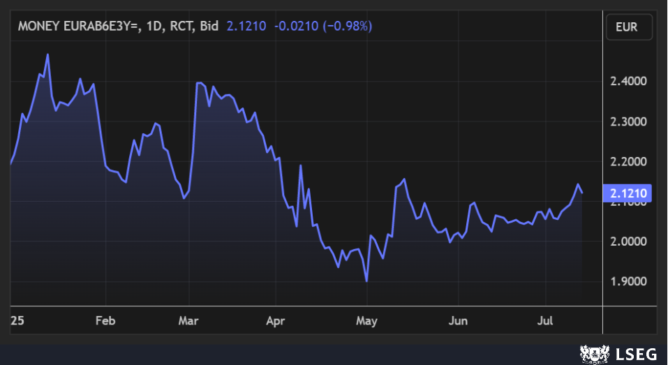
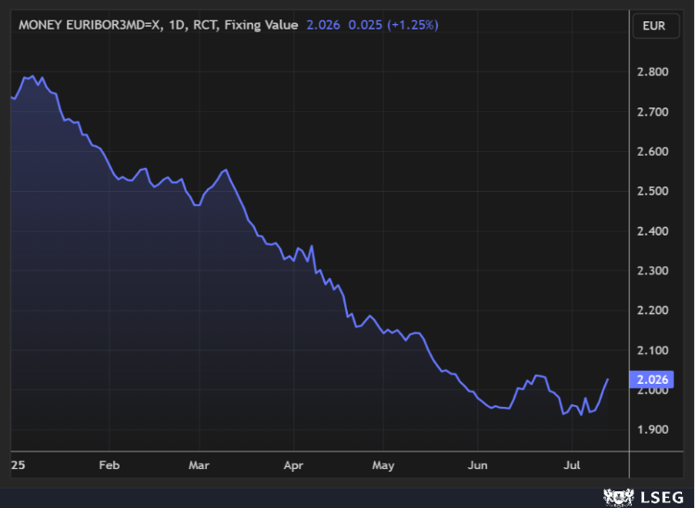
Q2 2025 Markets
Since the year-end, the graph below shows that the rate trended, albeit somewhat erratically, downwards to bottom out at 1.90% at the start of May
The rate is up almost 0.25% since but this would also be consistent with the market re-evaluating where the ECB Base Rate is likely to bottom out
The rate, in the short term, is likely to tread water until we know the outcome of the US/EU trade talks
Tariffs would inevitably lead to economic slowdown in the short-term requiring interest rate cuts. But they could also increase inflation which normally leads to higher interest rates. Hence the “holding pattern” for now
On balance, EU governments have debt capacity unlike the US and appear to be prepared to invest in their economies which should support economic growth and, by extension, interest rates.
Graph 6. EUR 3-year swaps YTD trend
3.3 EUR Summary
The trend in Graph 5 was predictable (downward) and expected up to now. But further ECB Base Rate cuts are on hold for the moment
Outcome of the US/EU trade talks will be crucial for the future direction of both short-term and long-term interest rates
The Eurozone yield curve i.e. the line that joins together all market rates from 3 months to 30 years is now a normal curve meaning that the bottom of the cycle is in sight (or already there?) and rates will have to move upwards in due course
And it looks like it has reached the bottom of the current interest rate cycle ahead of both the UK and US.
3. Interest and Economic Review
3.1 EUR/GBP
3.1 EUR Short-term Rates
While interest rates finally became topical in 2023 after years of zero rates, they have peaked in 2024 and are now close to the bottom of the current interest rate cycle with the Eurozone being further into the downcycle than the UK and the US.
We continue to monitor the 3-month Euribor rate for the purposes of this bulletin (as it is the most relevant one for variable rate debt).
Key Observations
3-month Euribor tracks the ECB Base Deposit Rate very tightly. The former changes every day while changes in the latter only arise on ECB meeting dates. As a result, Euribor tends to anticipate the ECB move a few weeks in advance
The graph below shows 3-month Euribor is now marginally above 2.00% having briefly dropped below that. The ECB Deposit Rate was cut to 2.00% at the meeting in June
The previous market view of where the ECB Base Deposit Rate will bottom out (1.50%/1.75%) has been revised after the last ECB meeting given the ECB perspective that inflation appears to be under control plus the risk of tariffs increasing inflation also puts a hold on any further rate cuts for now.
Graph 5. 3-month Euribor: YTD trend
3.2 EUR Medium-term Rates
We always look at 3-year swap rates as they are a better indicator of the future direction of interest rates
The 3-year fixed rate (before margin) fell from 3.21% in June 2024 to a low of 2% at the start of December as the market anticipated (and received) falling shorter-term rates.
Page 5

Slide 6
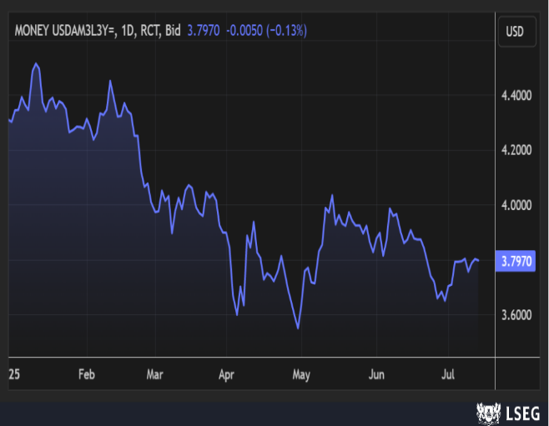
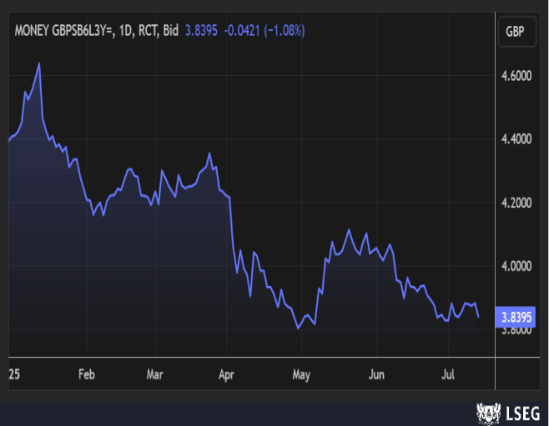
Q2 2025 Markets
3.4 UK and US Interest Rates
Graph 7 below shows the US 3-year swap rate while Graph 8 is the UK 3-year rate, both for the year to date
Similar to EUR fixed rates, these are a better indicator of the likely path/trend of medium-term rates
And while both have been trending downwards, it has not been in a linear fashion like short-term rates with sizeable upward moves and subsequent retracements
However, they do not yet appear to have reached the bottom of the cycle.
Graph 7. USD 3-year swap rates YTD trend Graph 8. GBP 3-year swaps YTD trend
In the US, the 3-year rate at 3.79% above is below both the 1-year fixed rate of 4.27% and the Fed rate of 4.50%. This would suggest that short-term rates have further to fall in the US
But markets are holding back for now as the finalization of trade deals and associated tariffs will dictate both inflation and GDP trends and, in both cases, it will probably have a material impact
Headline data in the US remains largely positive – unemployment is low, PMI readings are above 50 and consumer confidence is rising again
But there are other signs of possible trouble ahead in the housing market, retail sales (ex Autos) were negative in May and the Q1 GDP reading was also negative. And all of this before we look at government debt and deficits which, of course, is where financial markets globally are increasingly focused. As we mentioned in our previous bulletin, the US government has run a deficit i.e. it spends more than it takes in for over 20 years driving the government debt up to over $36 trillion at the end of 2024. As it runs deficits, it cannot repay debt as it matures meaning that it must borrow new debt to repay old debt
The sustainability of this become challenged when long-term interest rates are higher than GDP growth. The impact becomes exponential in that interest is added to debt and is compounded at a faster rate than the economy grows. And the current 10-year yield on US government bonds is 4.42%
As the US also depends on foreign buyers of US gilts to part fund their deficit, this must (should) be a consideration in trade talks
Finally, as President Trump wants interest rate cuts, he has launched several broadsides against the current Fed Chair, Jerome Powell, given the Fed’s resistance to such calls. Mr. Powell’s tenure ends next May and any attempt to remove him prior to that is likely to be seen very negatively by the financial markets. The result? Higher long-term bond yields as investors seek to be rewarded for higher perceived risk of investing in the US
It could also lead to a substantially weaker USD
In the UK, the Government continues to grapple with high debt and the consequences of years of poor economic management by the Tories. The recent rise in the (Farage) Reform Party won't have helped matters. Labour has a significant parliamentary surplus and time to sort matters out. But it could (will?) get worse before it gets better.
3.5 UK and US Summary
Same as last quarter: UK and US recession looks like a high probability in a penal tariff scenario with a major financial market correction in the US an additional smaller possibility.
Page 6

Slide 7
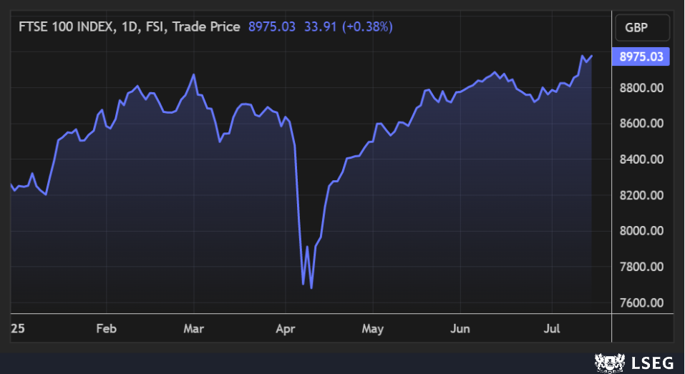
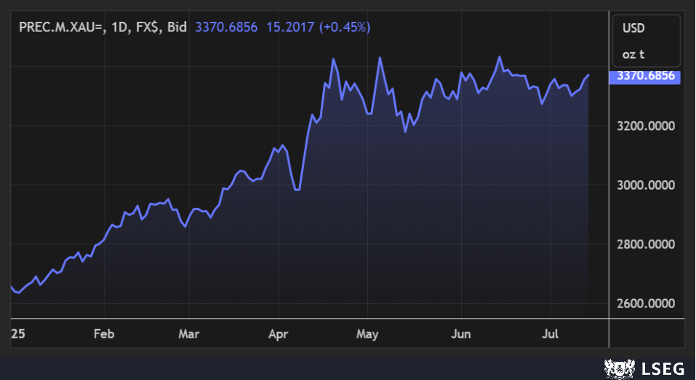
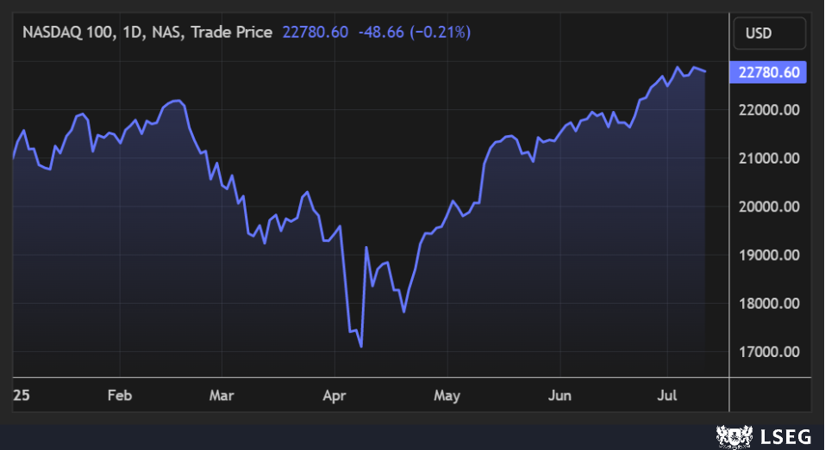
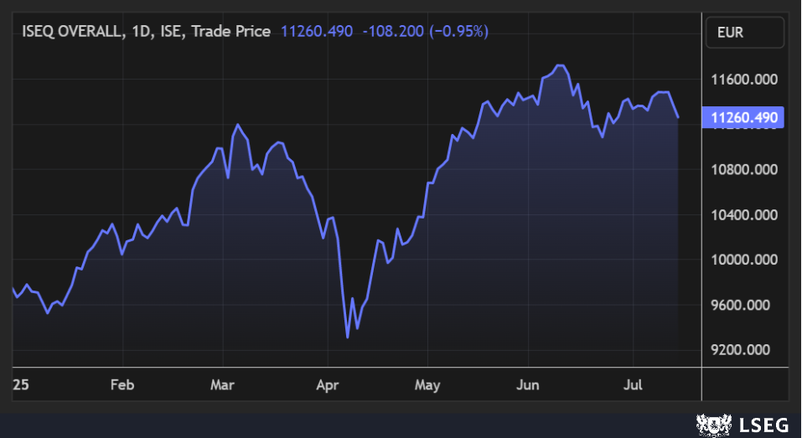
Q2 2025 Markets
4. Wealth Management
Graph 11. FTSE: YTD trend
Graph 12. NASDAQ: YTD trend
In summary while the US markets continue to rise (in USD terms), the attraction to foreign investors has been tarnished by the steep decline in the USD against EUR as this eliminates the index gains in EUR terms. By contrast both European and, to a lesser extent, UK equity markets have been in vogue and, in the case of the latter, probably ignored too much over the past few years.
Nervousness around the US government debt remains a material factor for consideration in the minds of non-US investors.
Earnings season has started strongly for the banks in the US and retail investors seem to be driving the equity markets higher as institutional investors remain more circumspect. We will see who has a better read of the situation in the second half of the year.
4.1 Gold
Graph 9. Gold prices YTD trend
Gold is one of the best performing asset classes in recent times. A few years ago it was viewed as a possible hedge against a recession. The 2024 rise in price was partly attributed to a reallocation of Chinese investors out of US stocks and shares and also some buying by Central Banks but 2025 to date has seen no halt in the value of Gold with USD3,400 being breached on a number of occasions recently. And with a very uncertain political outlook, there doesn’t appear to be a reason for now for the price to materially retreat.
4.3 Equity Markets
Equity markets have had a broadly positive start to 2025 but all dropped after the first missives from the US President on tariffs. Recovery since has been impressive.
Graph 10. ISEQ: YTD trend
Page 7

Slide 8
Q2 2025 Markets
5. Macro Commentary
As this is the Summer edition of the bulletin, we will keep this section brief.
The macroeconomic environment is very volatile as a result of numerous geopolitical issues:
Trump Presidency and associated events
Russia/Ukraine war
Developments in the Middle East.
In addition, the scale of US government debt and the two decades of fiscal deficits have finally got some of the attention they both deserve.
Gillian Tett in the Financial Times recently wrote an excellent article titled “The new age of geonomics”. The term geonomics was coined in a 1990 essay which described it as “the admixture of the logic of conflict with the methods of commerce”. The article is well worth a read but essentially the point is that the world is now seeing a greater intersection between economic and security interests. The danger highlighted is that when you have multiyear debt, political and geopolitical cycles, they can undermine imperial powers. The best quote? From Ray Dalio, founder of the Bridgewater hedge fund: “It’s like being on a boat heading for the rocks and everyone keeps fighting about whether to turn left or right”. But as can be seen from the previous sections of this bulletin, the actions of various “strong” Presidents and Prime Ministers are having a much larger impact on economic and financial market variables than in previous years.
On the Irish economic side, the Central Bank made a comment to the effect that if one was to strip out the excess corporation tax raised from our fiscal data, we have been running an underlying deficit for the past 17 years! This echoes the Celtic Tiger era to a certain extent. Then we financed ongoing commitment (expansion of public services) with short-term housing taxes. The problem with this is that where services are expanded, they are hard to contract e.g. Public sector employees cannot be let go so when their numbers increase, it is a potential 30-to-40-year financial commitment. This was funded in the noughties by tax receipts from construction…that was only capable of being repeated by continuing to build the same of number of houses year after year. But when 90,000 were being built annually for an average demand of 35,000, the revenue stream was doomed to dry up as supply and demand eventually needed to realign resulting in a large imbalance in the public finances.
Substitute windfall multinational corporation taxes for construction taxes and one could argue that a similar situation has prevailed….and for a much longer period. Last October the Department of Finance published a paper highlighting this same fact and indicating that we had underlying deficits of €6.3bn and €5.7bn in 2024 and 2025 respectively if one stripped out the receipts from the Apple case and other windfall corporation tax receipts. The problem with this is twofold:
Money that ought to be invested in capital programmes is being incurred on day-to-day spending and
The reality is much worse than the perception for day-to-day spending and, ultimately, is unsustainable.
And with very large multi-year investments required to tackle housing, electricity and water network constraints, climate change and (even in neutral Ireland) defence spending, the demands on public finances are increasing, large and imminent.
Allied to that will be higher demands on day-to-day spending for age-related costs as the population ages and a growing pensions bill (pensions are paid for out of current (day-to-day) receipts - there is no pension fund established to pay them per se) implying a lot of demands on the cost/investment side which can only be funded by borrowing or tax receipts.
All of this points to a critical juncture in the political and financial management of the State. We will have to do things more efficiently. Productivity will become more important. AI could help or hinder this. Innovation will be crucial and better co-ordination of public services will be vital e.g. housing (and jobs) need to be located in areas that can also be served more easily with utilities – a spatial plan of sorts even though that was first mooted/attempted 20 years ago!
The World appears to be at an inflexion point that could dictate the next 30 to 50 years. Ireland is no different. The requirement to be proactive is self-evident, the political will to do so may be the challenge as benefits won’t accrue over short-term election cycles. We live in interesting times.
Page 8

